Slide 1
Note to Parents
This resource is intended for children in Year 3.
The learning objective for pupils using this resource is to learn how to add two fractions with the same denominator.
______________________________________________________________
They should already be able to: understand that a fraction is part of a whole amount, colour in parts of a fraction (e.g. colour in ¼ of a circle split into four equal pieces), find parts of a fraction e.g. find ¼ of 24 sweets.

Slide 2
How to use this fraction resource
A ‘tutor my child’ lesson is taught through four, different
sections: Teach, Apply, Practise, Evaluate (TAPE)
The green slides TEACH the skill.
The orange slides APPLY the skill with guided examples.
The pink slides PRACTICE the skill through questions and
answers.
The blue slides EVAULATE the learning through a recap to
allow for assessment.

Slide 3
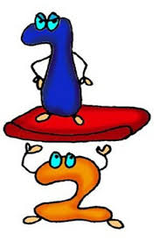
Today we are learning to: Add two fractions together with the same denominator.

Slide 4
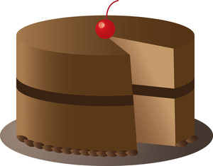
TEACH: A fraction is part of a whole amount of something.
If you have a
slice of a
cake, you have
eaten part of it.
You have eaten a
fraction of the
cake. There is still some cake left!
I only ate a fraction of the cake. I left some for my family.
Notes:
Note to parents – A fraction is a way of expressing how much has been eaten. Make sure that this concept is clear. You could use physical examples to demonstrate this. E.g. Have a collection of pencils and a pot. Place some of the pencils in the pot. Say: I have put a fraction of pencils in the pot. Repeat with further examples as required. Try and use ‘fraction’ in general conversation. E.g. You might say, ‘I have put some washing away.’ Try saying ‘I have put a fraction of the washing away.’ etc

Slide 5
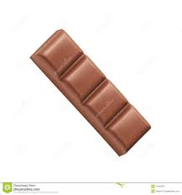
TEACH: What does a fraction tell us?
The top part of the fraction is called
the numerator. It tells you how much
of the fraction you are allowed.
E.g. You might be allowed ¼ of the bar
of chocolate but your friend might be
allowed ¾ of the bar of chocolate.
1
4
The bottom part of the fraction is called
the denominator. It tells you how many
parts there are in the fraction.
E.g. This chocolate bar is split into four equal
pieces. BUT it could have been split into ten
equal pieces.

Slide 6
TEACH: How to add two fractions.
Step Two
Add the numerators in all the fractions together.
3
1
4
Step One
Check the denominators are all the same.
+
=
5
5
5
Step Three
DO NOT ADD THE DENOMINATORS together. The fraction must still show that there are five pieces in total.
Notes:
During the explanation it is important to make it clear that we do not add the denominators together.
Explain that we must show that the fraction is still split into five pieces. We do this by not changing the denominator.
The numerator changes because the amount of the fraction increases.
DO NOT TEACH ‘just add the two top numbers.’ if you inform children of this ‘rule’ it will confuse them in future learning and will impact on their understanding of adding fractions when the denominators are different.

Slide 7
APPLY: How to add two fractions.
Now we are going to work through the next example together. It is your job to try and explain what we do when we are adding fractions together.
Don’t worry if you forget, my step by step guide will still be there to help you after each prompt question!

Slide 8
APPLY: How to add two fractions.
Step Two
What do we need to do with the numerators?
Add the numerators in all the fractions together.
Did you get this answer?
4
3
7
+
=
Step One
What do we need to check first?
9
9
9
Check the denominators are all the same.
Step Three
What should we do to the denominators?
Do not add the denominator together because the fraction must still show that the fraction is split into ninths.

Slide 9
PRACTICE: Add these fractions
Did you remember to add the numerators together?
Can you remember why the denominator doesn’t change?
3
4
7
+
=
10
10
10
2
9
11
+
=
12
12
12
1
6
7
+
=
8
8
8

Slide 10
PRACTICE: Find the missing fraction
1
2
3
+
=
HINT!
Think carefully about what happens to the denominator when you add fractions together!
4
4
4
5
1
6
+
=
8
8
8
3
5
8
+
=
9
9
9

Slide 11
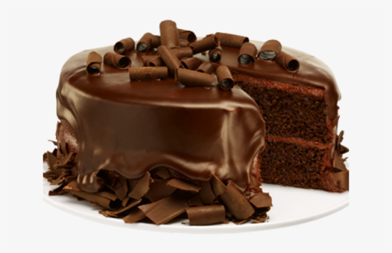


PRACTICE: Problem Solving
Julian eats $\frac{3}{8}$ of
the chocolate cake.
Louisa eats $\frac{2}{8}$ of
the chocolate cake.
How much of the chocolate cake has been eaten in total?
How to solve this problem:
Turn the word problem into a fraction number sentence $\frac{3}{8}$ + $\frac{2}{8}=$
Then complete the fraction number sentence.
The answer is: $\frac{5}{8}$
HINT!
ANSWER!

Slide 12
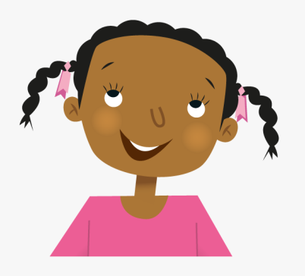
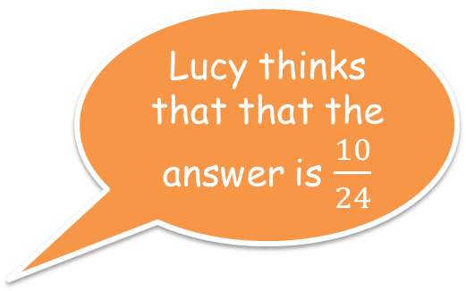

EVALUATE: Use your knowledge to explain your understanding
Sabrina thinks that the answer is $\frac{10}{12}$
$$\frac{7 }{12}+ \frac{3}{12}=$$
Lucy thinks that that the answer is $\frac{10}{24}$
Who is correct?
Explain how you know.
Sabrina is correct because she has remembered that the denominator must stay the same to show that the fraction is still split into twelfths.

